Slide 1

CASTLE DORE ROWING CLUB
Castle Dore Rowing Club (CDRC) Induction for Members
Version v4 November 2018
Registered Charity No. 1111204

Slide 2

Welcome
Welcome to Castle Dore Rowing Club
This short Induction is designed to give you a quick orientation of the Club
It will draw your attention to a number of key areas to be aware of, which will ensure that you have some enjoyable and safe times at the Club
If you have any further questions or for further information, please speak to either another Club Member or Coach
We hope you enjoy being a Member of Castle Dore Rowing Club!

Slide 3

Club Officers
President: Robert Treharne-Jones
Chairman & Junior Coordinator: Alastair Barr
Secretary: Andrea Chapman
Treasurer: Anthony Jones
Captain: Elaine Buck
Vice Captains: Robin Mills / Jo Virr
Welfare Officer: Mary-Jane Hunter
Water Safety Adviser: Paul Hughes
Website: castledorerowingclub.org.uk

Slide 4
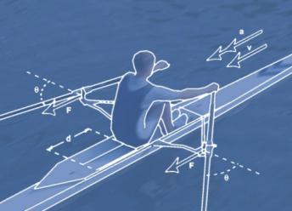
Coaches
CDRC Coaches are:
Alastair Barr
Peter Cameron
Robin Mills
Richard Wakefield
Coaches may restrict boating if:
The river flow rate is too high
Visibility is poor
It is too cold to row
If wind and / or tide make water conditions too rough
Tide conditions don’t allow safe boat launching / recovery

Slide 5

Welfare
Every CDRC member has a duty of care towards others
The Club has a Welfare Officer who is responsible for advising on child protection matters and dealing with any welfare concerns expressed by juniors or others
All adults at the club who work unsupervised with children are required by British Rowing to undergo a CRB / DBS Check
The Club has adopted the British Rowing Safeguarding & Protecting Children policy and which is available on their website

Slide 6
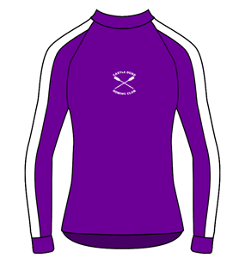
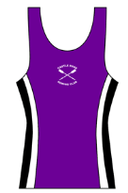
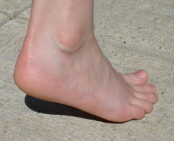
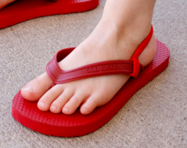
Clothing
Clothing needs to be:
Comfortable so that you can move easily
Not too baggy so that it will get caught on equipment
Not restrictive
Suitable for the weather conditions. When out on the water you will be more exposed to the elements
Wear wellies / wetsuit boots when in the Boathouse / on the slipway as you may not be able to see possible hazards in the water. Don’t go barefoot and don’t wear flipflops.
But don’t wear wellies when coxing!
X
X

Slide 7

Safety Notice Board
The CDRC Safety Notice Board is located downstairs in the Boathouse
Check it for regular updates including British Rowing Alerts
Risk Assessments are completed for activities undertaken at CDRC
The Incident Record Book is also available on the Safety Notice Board

Slide 8
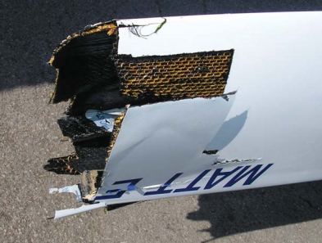
Incidents
Please log incidents in the Club’s Incident Book (Purple cover and hanging on the Safety Notice Board).
Please also report it to British Rowing Incident Reporting portal by visiting their website https://incidentreporting.britishrowing.org/ You do not need to be a British Rowing member to report an incident.
Make sure you report the following:
  Capsizes
  Collisions
  Swamping
  Health issues (infections)
  Shore-side accidents
  Any “Near Misses”

Slide 9

Competence
No inexperienced crew or sculler should go out without supervision.
The Club maintains a list of competent rowers who are authorised to lead outings or go afloat unsupervised.
Before going out, YOU must do your own risk assessment. Check:
  The tides / state of tide.
  The weather forecast
If in doubt - don’t go out

Slide 10
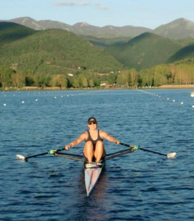
Training Alone
There are risks associated with training alone
As a result, you will benefit from and be safer by having a training partner
Why not arrange training sessions with other Club members?

Slide 11
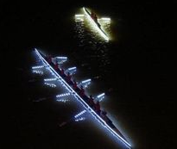
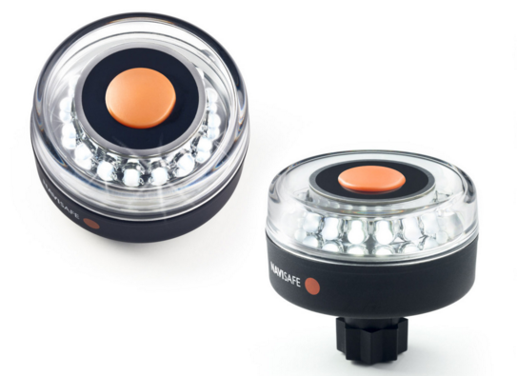
Poor Visibility & Night Rowing
If possible, avoid rowing in the dark or foggy conditions
If you must row in the hours of darkness, then you must:
  Have a white light showing both fore and aft
  Wear bright or reflective clothing
  Make sure someone knows you are on the river

Slide 12

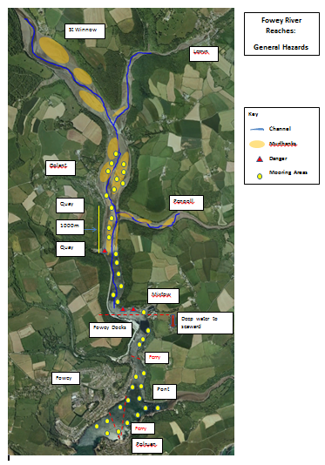
Navigation Rules
A simplified map is available on the Safety Notice Board
This includes the location of local hazards
Pay particular attention to the navigation and shipping hazards in the area seaward of the berths at Fowey Docks

Slide 13
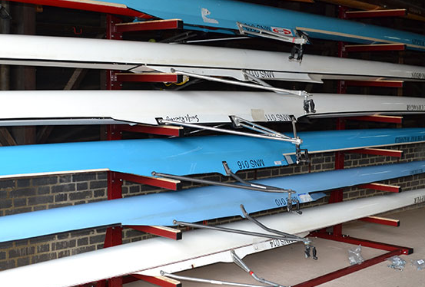
Equipment
Check with Coaches and Captains before using any equipment
Remember that Boats are designed for crews members of differing weights!
Look after equipment as it is very expensive!
Some of the equipment in the Boathouse is privately owned
You must know the correct way to use equipment. If in doubt ask
If you damage anything, then please identify it and report it

Slide 14
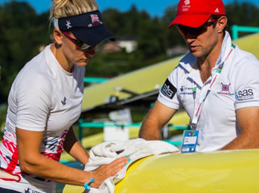
Boat Storage
Know how to safely remove a boat from its storage rack
Have trestles ready before you start to remove a boat from its storage rack
Boats and oars must be washed down with fresh water and dried after each use before they are stored correctly
Boats need to be replaced on their racks in the correct direction as indicated ie bow out or stern out
Always ask for help if you need it!!

Slide 15
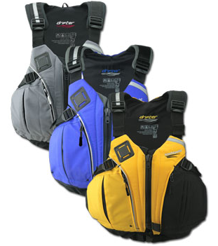
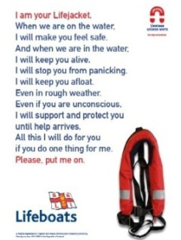
Safety Equipment
Lifejackets or Personal Floatation Devices (PFDs) must be worn when on a Safety Boat and by all Coxes
If you cannot swim 100 metres then you must wear a lifejacket / PFD on the water
Lifejackets / PFDs are stored on hooks in the Boathouse
Make sure you use one which is suitable for your weight! Check the label.
Check it for wear and tear before use and know how to fit it correctly, including the crotch-strap
Our lifejackets are not self-inflating. You will need to inflate it by pulling the toggle

Slide 16

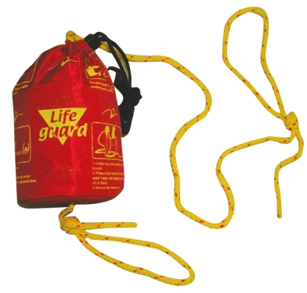
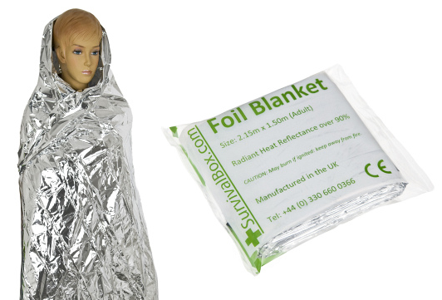
Safety Equipment
Throw ropes are to be used when recovering someone from the water
They are available in Safety Boat grab bags
Foil emergency blankets which are waterproof, windproof and conserve heat are also available in the Safety Boat grab bags.
They should be used by someone who has capsized and then is recovered from the water

Slide 17

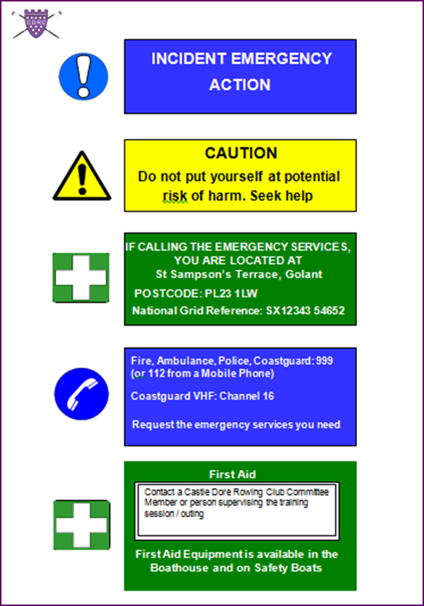
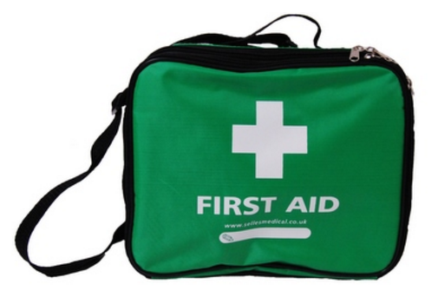
First Aid
First Aid kits are available downstairs in the Boathouse and in the Safety Boat grab bags
If you need an Ambulance, call either 999 or 112
There is a defribrillator located at the Fishermans’ Arms
The Boathouse location is St Sampson’s Terrace, Golant PL23 1LW

Slide 18
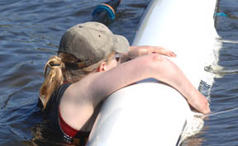
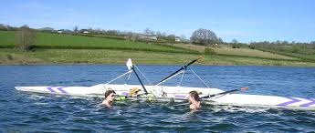
Capsize
If it happens:
Stay with your boat. Don’t swim away from it, as in cold conditions your swimming ability will be dramatically reduced
As a last resort, your oars will provide some floatation
Shout for assistance
All rowers and Coxes must have successfully completed a Capsize Drill

Slide 19

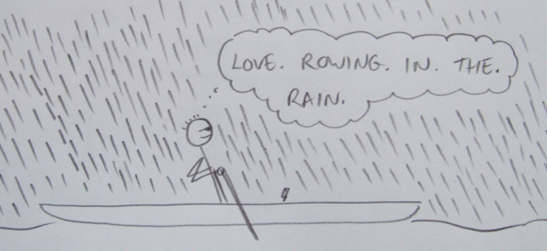
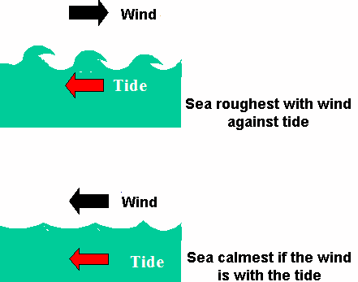
Weather
Coaches will assess the weather, river and tide conditions and decide if it is suitable and safe to row
There is the risk of hypothermia if you capsize or fall in. Always wear appropriate clothing
Wind can make rowing more difficult
Visibility can be affected by mist or fog
Do not row when lightning is forecast
It can also be hot (sometimes). Think about the effects of heat (sunstroke or sunburn)

Slide 20
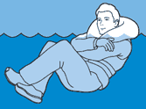
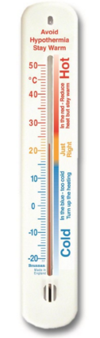
Cold Water Immersion
If you end up in the water:
Stay afloat! Keep your head and face out of the water
Stay calm. The effects of cold shock will pass
Stay with the boat. The boat will provide you with floatation
Get out of the water. If you can’t get back into your boat, then use it as floatation and use the hull as a means of getting yourself out of the water

Slide 21

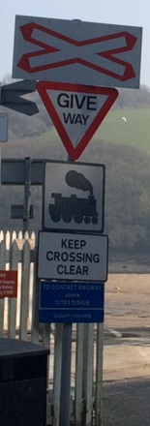
Road & Rail
The Boathouse is located on a narrow public road
Always be aware of traffic when moving / loading boats
Try not to obstruct traffic. Thank anyone who is held up by us
Never assume that a driver has seen you. Always check
The railway crossing at the top of the Slipway is potentially hazardous, including slip / trap hazards
Always follow the Network Rail instructions. Only cross the track at the crossing.
Do not leave any equipment on or near the crossing point

Slide 22

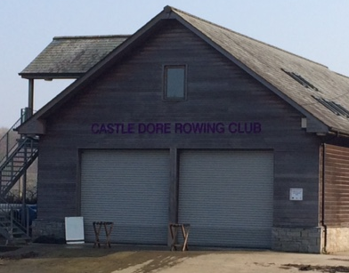

Club / Boathouse
The Club is a No Smoking location
Look after your valuables
Leave the Club facilities clean and tidy
Wash up crockery and cutlery
Close windows / doors and check / switch off lights / heating when you leave
Always make sure the Boathouse is secure
Report any damage / damages
Report anything suspicious

Slide 23
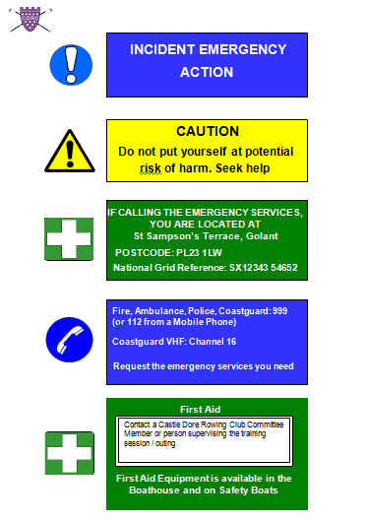
Boathouse: Fire Procedures
The building is fitted with an automatic fire detection system
Fire exits are identified. If at any time you see they are blocked, sort it and report it to a Committee Member
Read the Fire Action notices
In the event of a fire, only use the supplied fire extinguishers to allow you to make a safe escape
In the event of a fire, assemble by the Golant Boatwatch Hut – ask where this is!

Slide 24

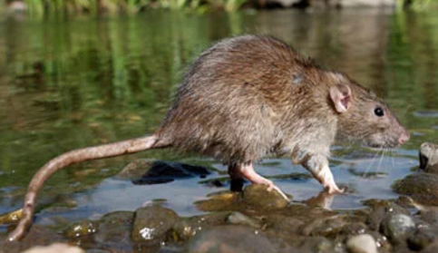
Water Borne Diseases
The water in rivers and estuaries is not clean!
Weil’s Disease:
  Small risk but can be serious
  Caused from contact with infected animal urine
  Enters the body through cuts / abrasions or via lining of nose, throat, mouth or eyes
  Leads to flu-like symptoms which develop 7-14 days after exposure
  If in doubt, see your Doctor advising them of recent exposure to river water
River water will also be polluted
with run off from fields, farms etc

Slide 25

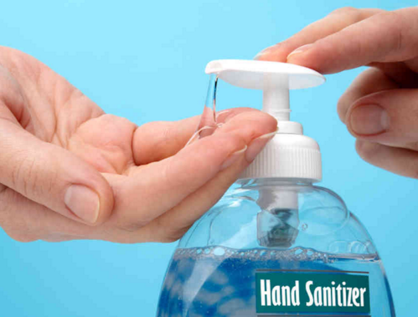
And finally…….Hygiene
Good practices will minimise the chances of ill health:
Never drink river water!
Wash your hands before eating or drinking
Cover cuts and abrasions with a waterproof dressing before rowing. If you cut yourself, wash the wound
Wear the correct footwear
Don’t use river water to cool yourself down
Keep rowing equipment clean. Wash it down regularly with fresh water
Use hand sanitisers
Don’t share drinks bottles

Slide 26

What’s next?
Have a look around the facilities upstairs, boathouse and store
You will see the slipway / Pill as well as the rail crossing and public slipway
You will be shown the location of First Aid and safety equipment, Fire Exits and Fire Assembly Point
Please remember that Safety is everyone’s responsibility.
When preparing to row / boat, don’t feel that you HAVE to go out.
Thank you for your attention

Slide 27
Induction Acknowledgement Form
Member’s Name (Print):
Member’s Signature:
Date of Induction:
Induction delivered by:
--------------------------------
CDRC Use: Return completed form to Membership Secretary
Added to Database (Date):

